Slide 1
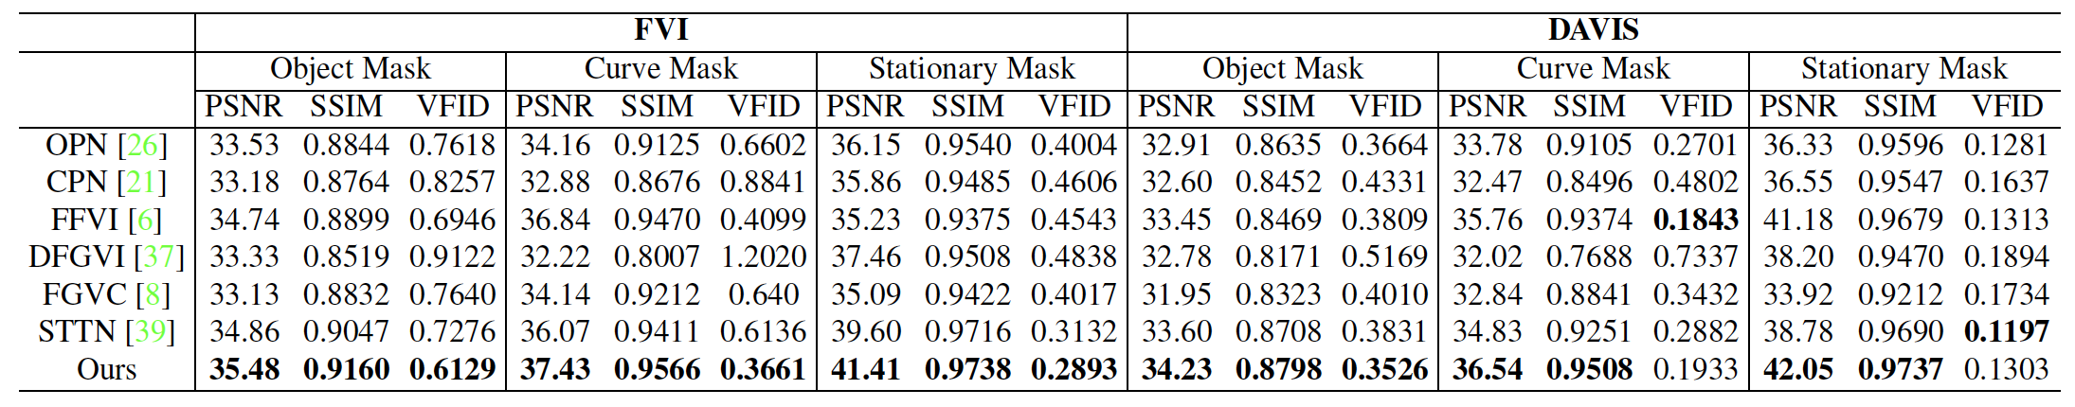
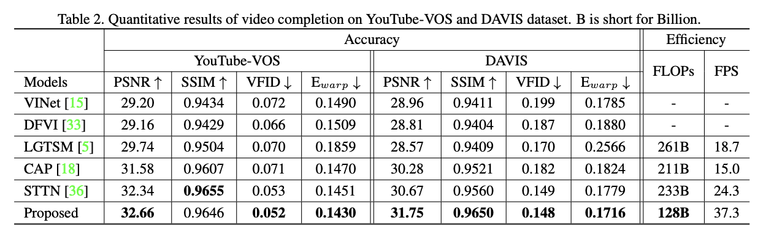
Progressive Temporal Feature Alignment Network for Video Inpainting
Decoupled Spatial-Temporal Transformer for Video Inpainting

Slide 2
 | PSNR | SSIM | VFID | LPIPS
Image Inpaint | 23.34 | 0.824 | 0.059
Huang | 28.04 | 0.858 | 0.035
Onion | 30.19 | 0.900 | 0.026
Copy | 28.37 | 0.851
STTN | 29.05 | 0.927
FGVC | 29.68 | 0.942 |  | 0.0564
InterVI | 29.90 | 0.944 |  | 0.0414
CAP | 28.04 | 0.906 |  | 0.1041

Slide 3
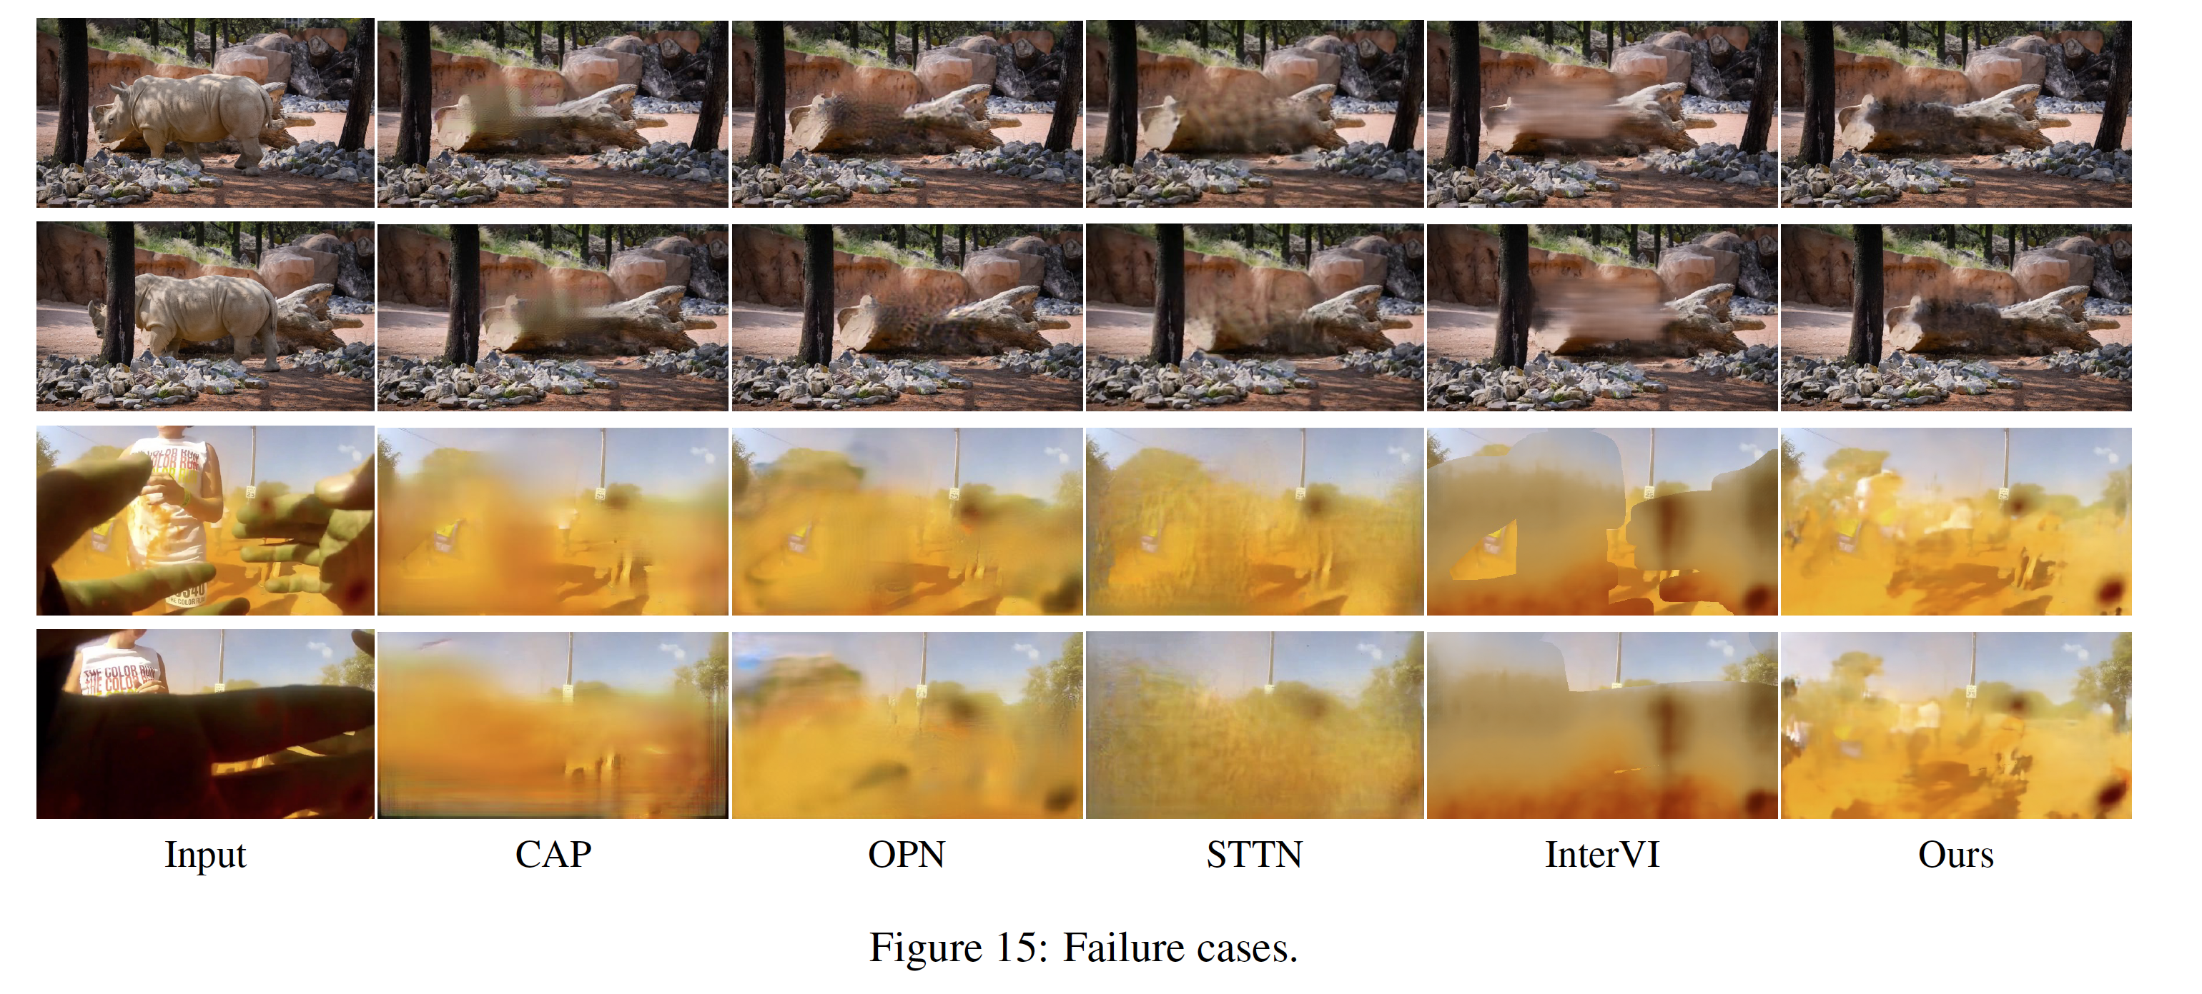
Failure cases
朦版的时候，还有就是complete occluded的

Slide 4
如果测试视频与训练数据有很大差异，它仍然可能会失败
Furthermore, inferring temporal coherence relies on 3DCNN so that large motion cannot be easily captured due to the limitation of the size of receptive field.
networks for optical flow inference still could not capture object motions in detail
A possible solution is to design a temporal attention and warping network that could replace the optical flow warping.
与 DIP [40] 和许多其他基于反向传播的视觉合成系统的情况一样，处理时间长是我们方法的主要限制
It often takes hours to train an individual model for each input video.
complete occluded. hole is large and has little motion relative to the background.

Slide 5
It remains an open question that, in the context of internal learning, what network structure can best serve as a prior to represent video sequence data.
我们计划研究具有显式网络内时间建模的更高级架构，例如 Vid2Vid [42] 中的循环网络和序列建模。
explicit in-network temporal modeling, such as recurrent networks and sequence modeling in Vid2Vid [42].

Slide 6
FGVC suffers from structure misalignment in all three cases (e.g. the boxing fence is misaligned, the man’s legs are incorrectly inpainted, and the wall around the stroller also suffers from incorrect structure). Although STTN can inpaint plausible content, it tends to generate blurry results in most cases. Lastly, FFVI generates artifacts in some cases (e.g. yellow color around boxing fence, white blob on jeans).

